Slide 1
Data Modeling MSBA BAN 6020 Data Management
Carolina Salge

Slide 2
Data Modeling
Design technique for modeling data
A graphical representation of a database
Two important aspects of data modeling:
Identify the facts to be stored in the database
Partnership between the client and analyst

Slide 3
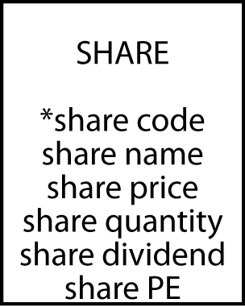
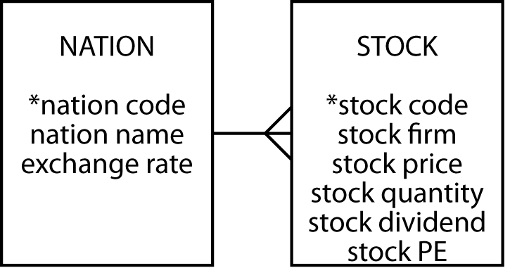

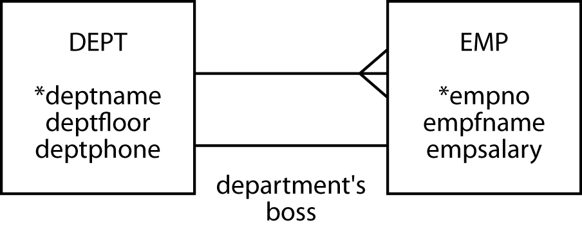
Building Blocks
Entity
Attribute
Identifier
Relationship

Slide 4
Quality
To be of high quality a data model must
Be well formed
Have high fidelity

Slide 5
Well Formed
No ambiguity
Building blocks are properly defined
Relationships are labeled when needed
Correct notation is used
Names are meaningful to the client

Slide 6
High Fidelity
Faithfully describes the world it is supposed to represent and makes sense to the client

Slide 7
How to Improve
Is the level of detail correct?
Are all exceptions handled?
Is the model accurate?

Slide 8
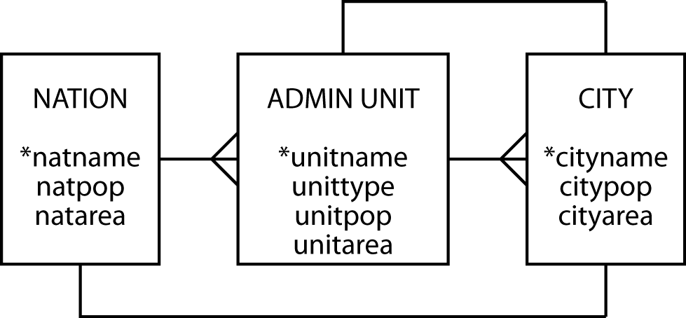
Geography
Storing details about cities in the world
Can a city be the capital of more than one state?

Slide 9
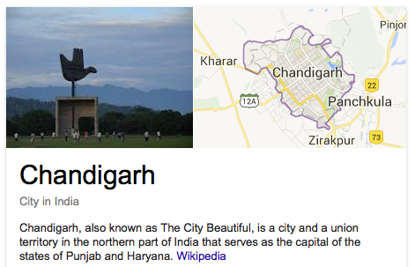
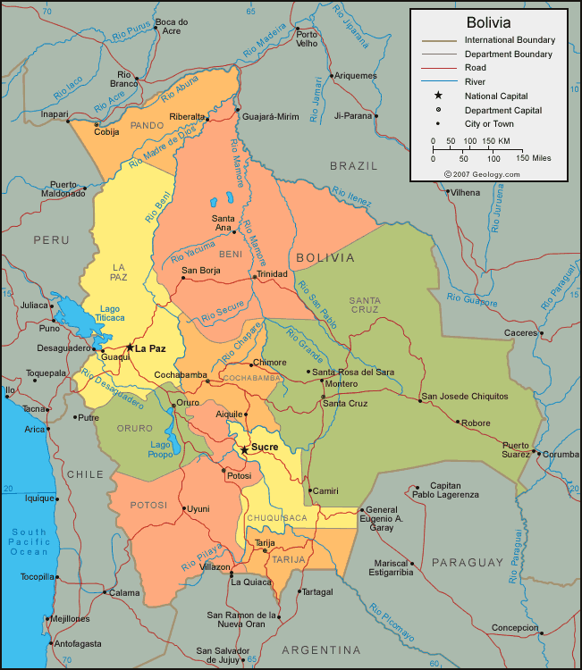
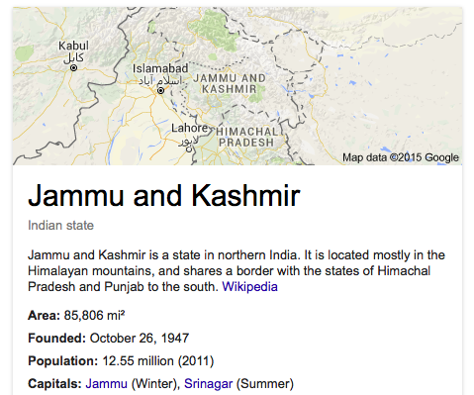
Geography

Slide 10
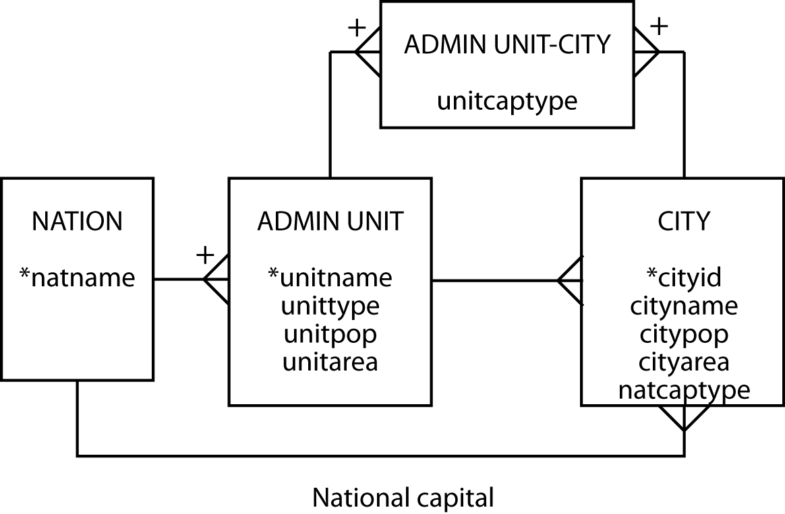
Geography Revisited

Slide 11
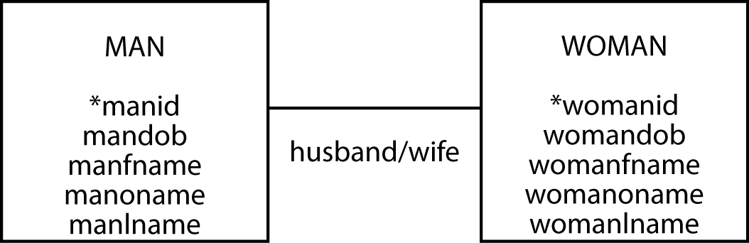
Family
Can we reduce the redundancy?

Slide 12
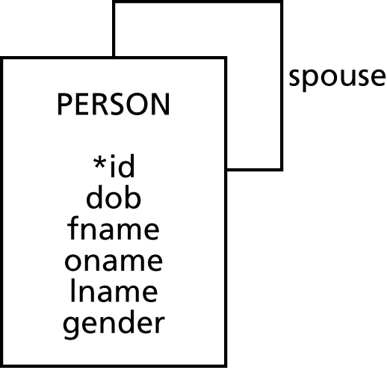
Family
A person can have only one spouse and a spouse can be married to only one person. But, is this always true?

Slide 13
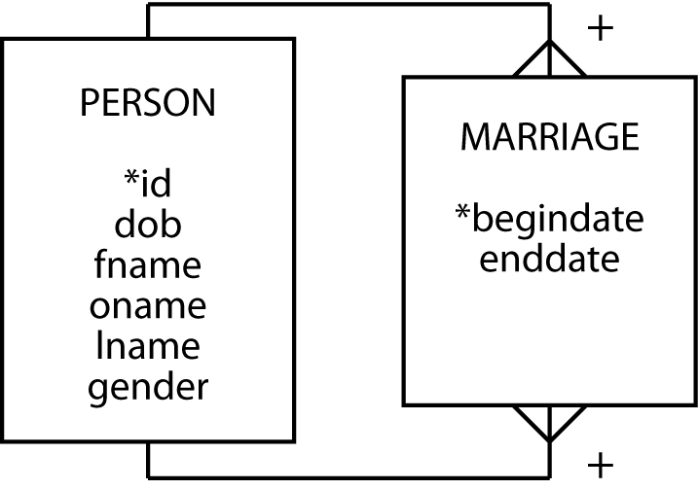
Family
What about couples who don’t officially get married but are considered married by law?

Slide 14
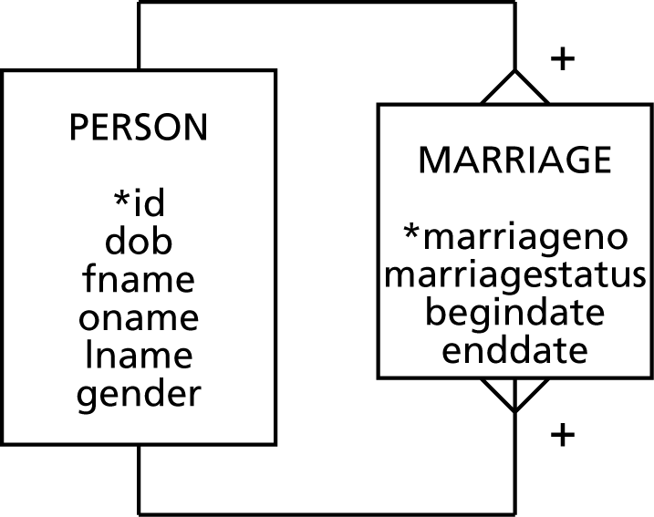
Family
What about children?

Slide 15
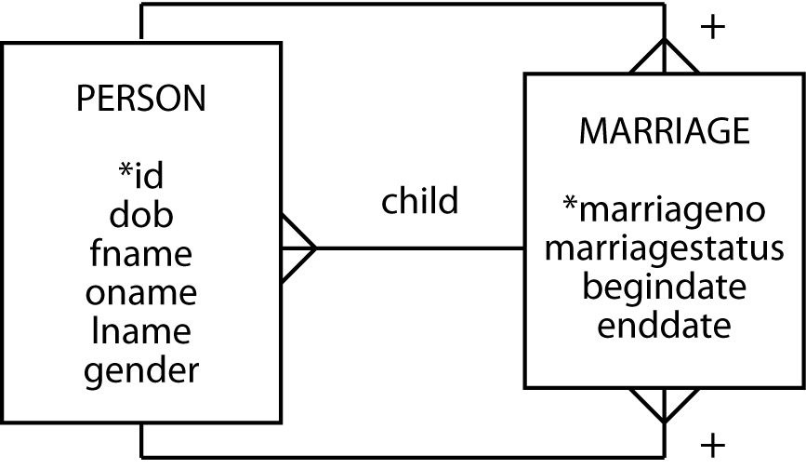
Family

Slide 16

Library
Why don’t we use book copy as an attribute of book?

Slide 17


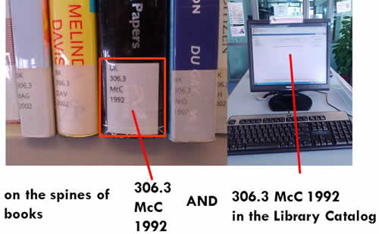
Library
This model records only the current borrower of a copy of a book

Slide 18
Exercise
A plane is leased to an airline for a specific time period. When a lease expires, the plane can be leased to another airline. There is an agent responsible for handling each deal. Agents can lease many planes and deal with many airlines. Airlines can deal with many agents too. Transactions occur when agents reach a deal with airlines to lease planes
Create the data model for this scenario

Slide 19
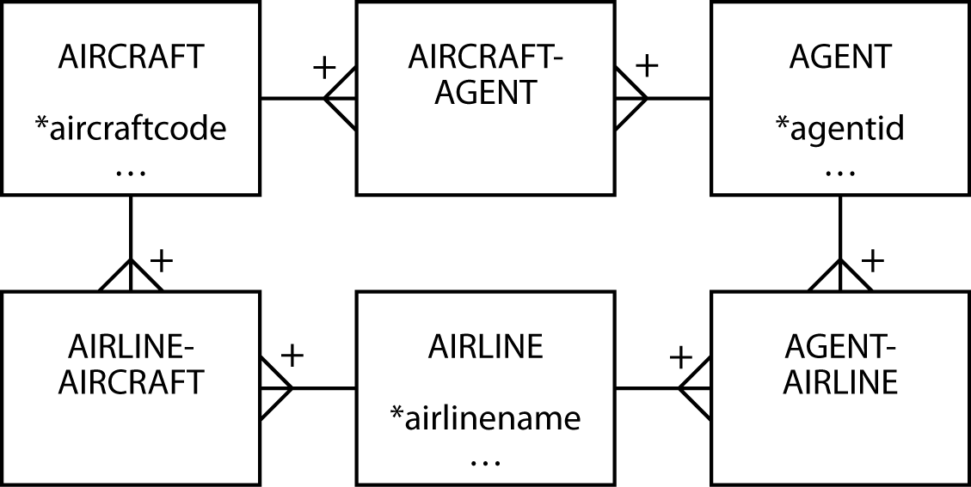
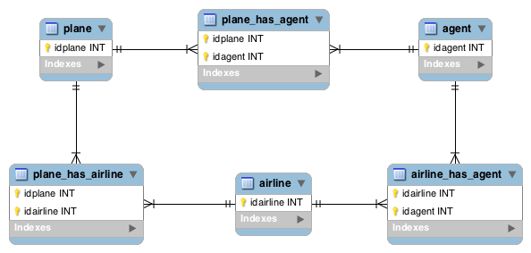
Exercise
But, where do we store data about leases?

Slide 20
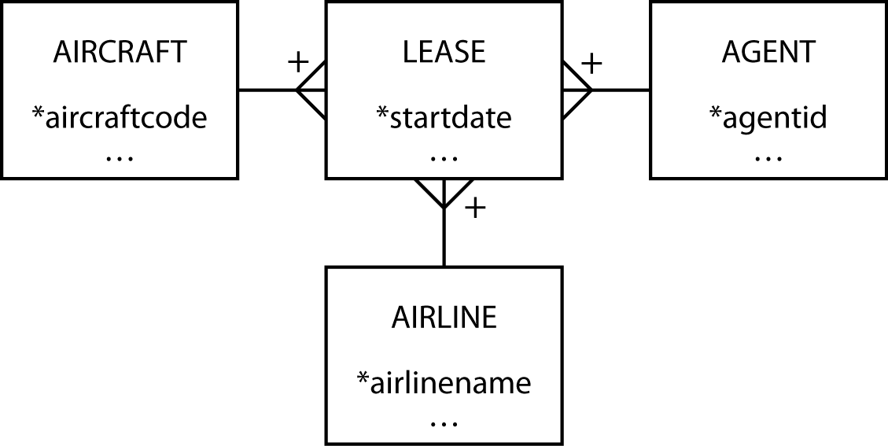
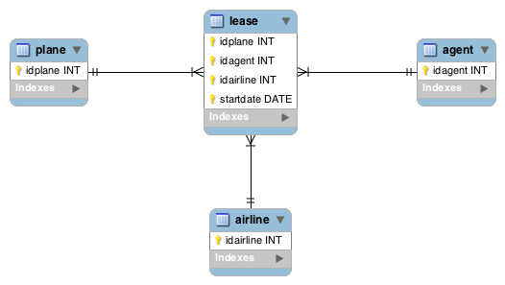
Exercised Revisited
Why does start date need to be part of the concatenated primary key?

Slide 21
Note to Carolina
Stop here! Finish chapter 7 next class

Slide 22
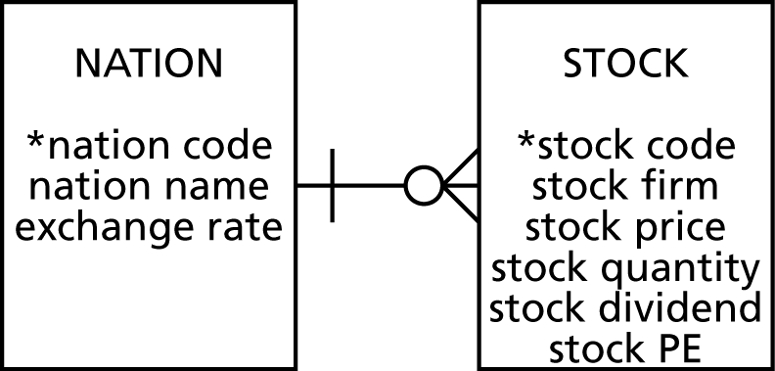
Cardinality
The multiplicity of a relationship
There must be 1 instance

Slide 23
Modality
Also known as optionality
Does an occurrence of this entity require an occurrence of the other?
Notes:
It is mandatory for an instance of stock to have an instance of nation, but it is optional for an instance of nation to have an instance of stock,
which means we can record details of a nation for which we do not have stocks

Slide 24
Cardinality and Modality
Cardinality | Modality | Meaning
0,1 | Optional | There can be zero or one instances of the entity relative to the other entity
0,n |  | There can be zero or many instances of the entity relative to the other entity
1,1 | Mandatory | There is exactly one instance of the entity relative to the other entity
1,n |  | The entity must have at least one and can have many instances relative to the other entity

Slide 25

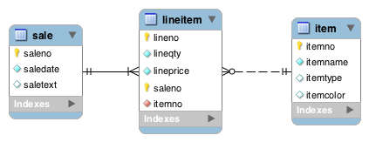
Cardinality and Modality
Mandatory
Optional

Slide 26
Entity Types
Independent
Dependent
Associative
Aggregate
Subordinate

Slide 27
Independent
A good starting point
Prominent in the client's mind
Often related to other independent entities

Slide 28
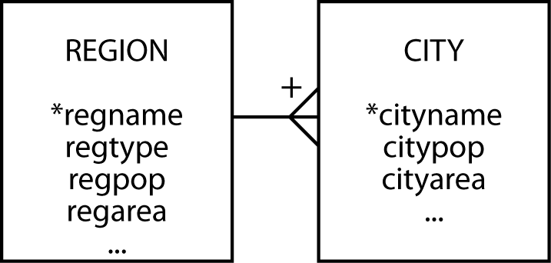
Dependent
Relies on another entity
For both its existence and identification
Can be independent if given an identifier

Slide 29

Associative
A by-product of an M:M relationship
Typically between independent entities
Can store current or historical data
Can be independent if given an identifier

Slide 30
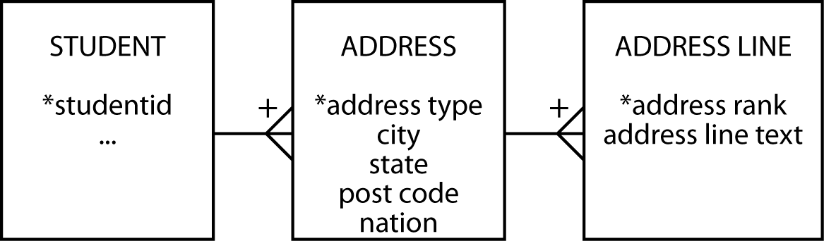
Aggregate
Serves many entities with a common prefix
Commonly used with addresses or names

Slide 31
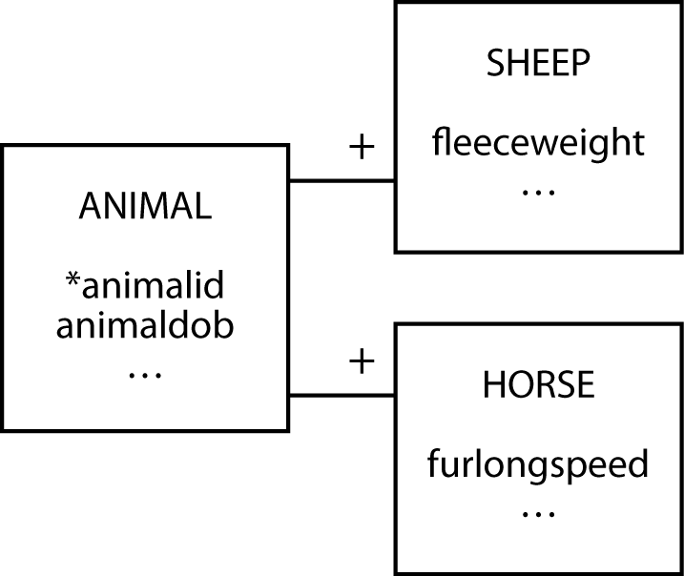
Subordinate
Contain data that can vary among instances

Slide 32
Names and Addresses
Query test
If an attribute has parts, are any of the parts ever likely to appear in a query?

Slide 33
Data Modeling Hints
Invent identifiers where necessary
Identifiers should have only one purpose – identification
Be consistent with attribute meaning
Uncover all exceptions
Keep models well formed and faithful
Concatenate weak entities if necessary

Slide 34
Habit of Great Modelers
Immerse
Challenge
Generalize
Test
Limit
Integrate
Complete

Slide 35
Recap
Introduced
Data Modeling Quality Assessment
Cardinality and Modality
Aggregate and Subordinate Entities
Reviewed
Entities
Attributes
Identifiers
Relationships

Slide 36
Next Class
SQL (10)
select natname, shrfirm, stkqty from stock, nation
where stock.natcode = nation.natcode and stkqty >
(select avg(stkqty) from stock
where stock.natcode = nation.natcode);

Slide 37
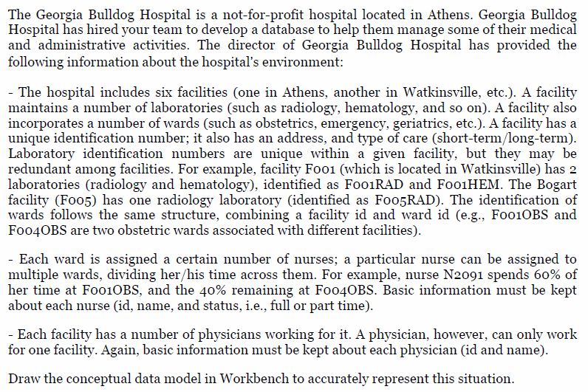
Bonus Exercise

